Slide 1

Welcome:
Cooper Kinney
Director – International SOS

Slide 2
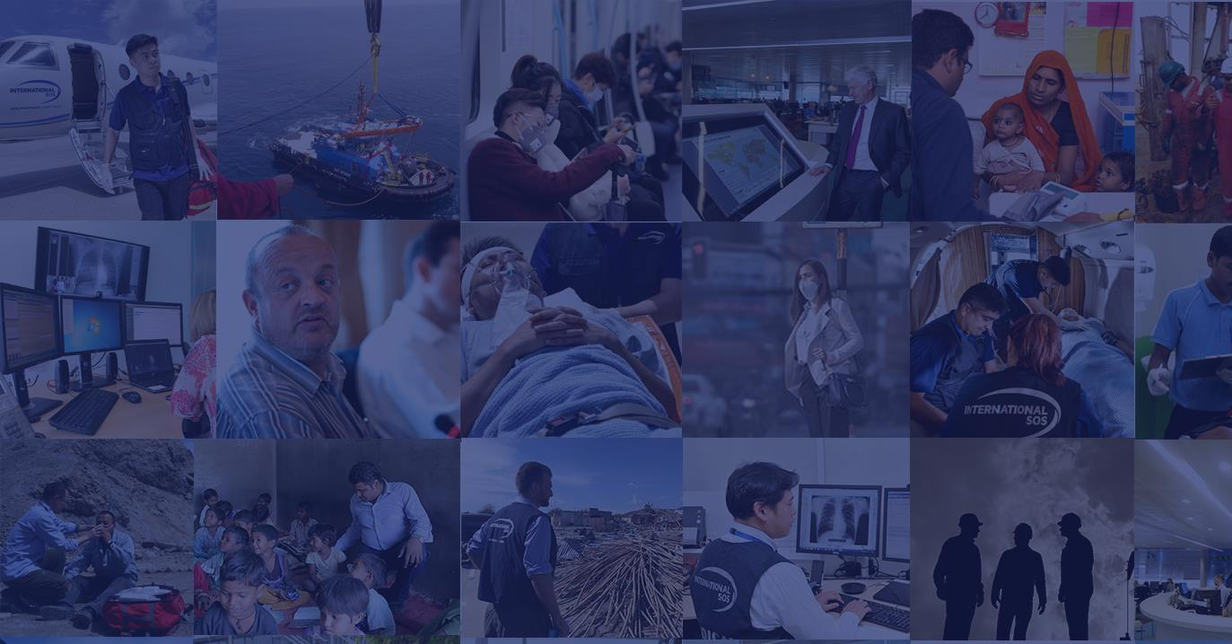

TRAVEL & EVENTS
RISK MANAGEMENT
WHAT’S ON TAP FOR TRAVEL RISK MANAGEMENT IN 2024
GBTA CHICAGO – QUARTER 1 MEETING

Slide 3
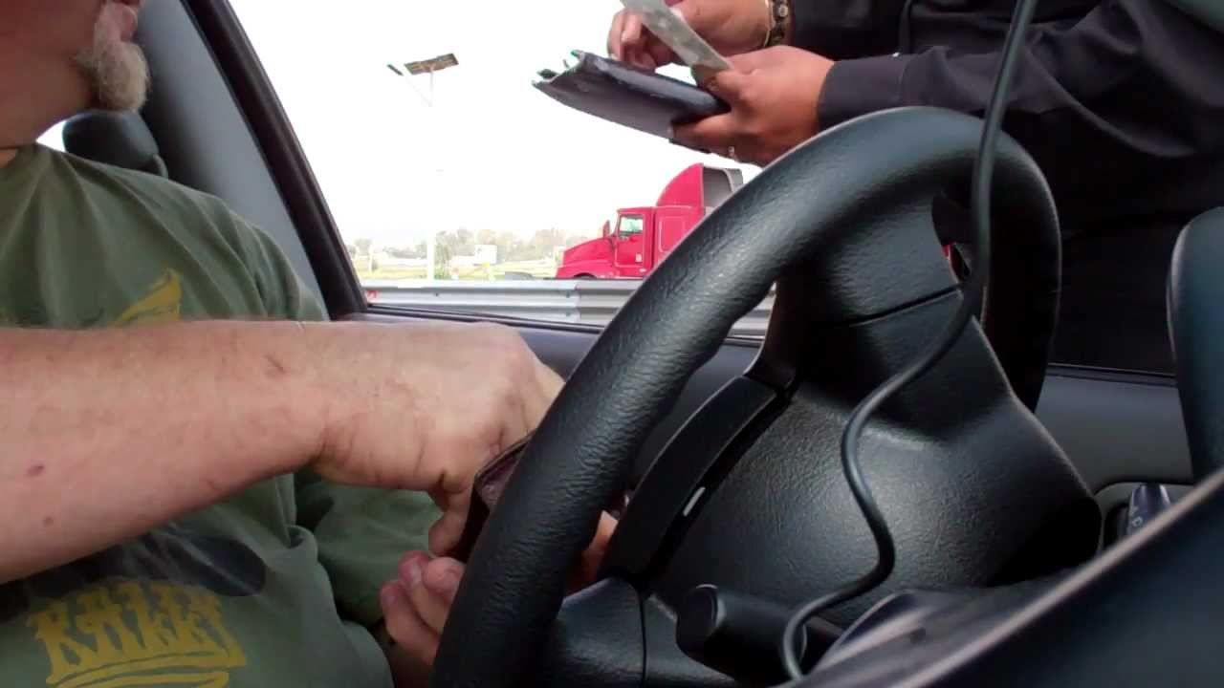
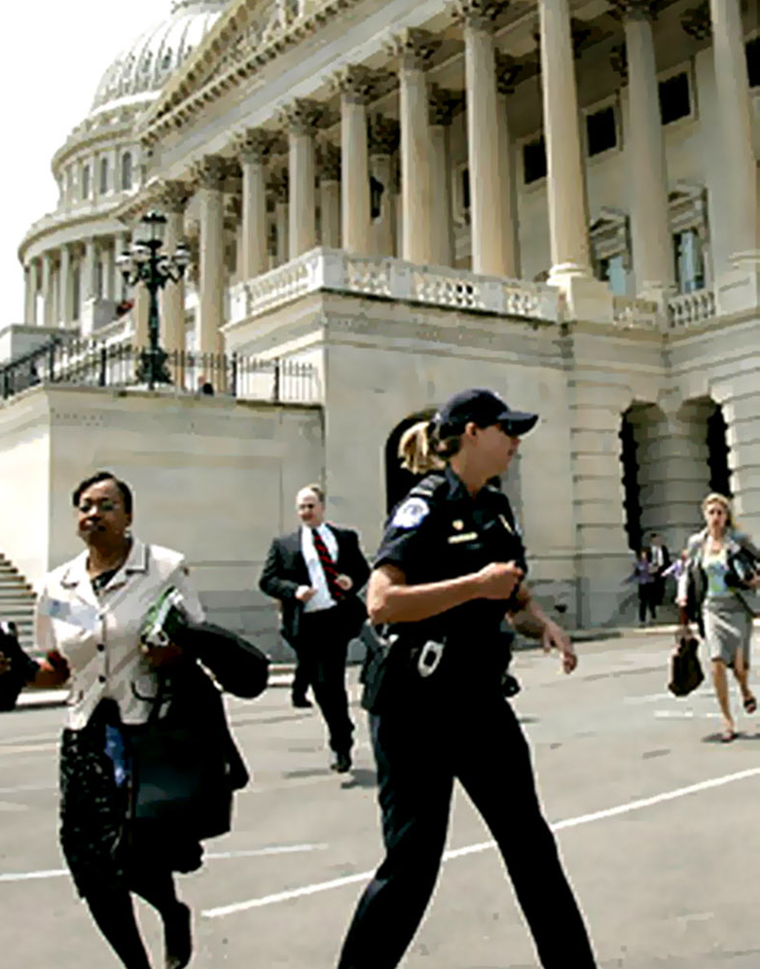
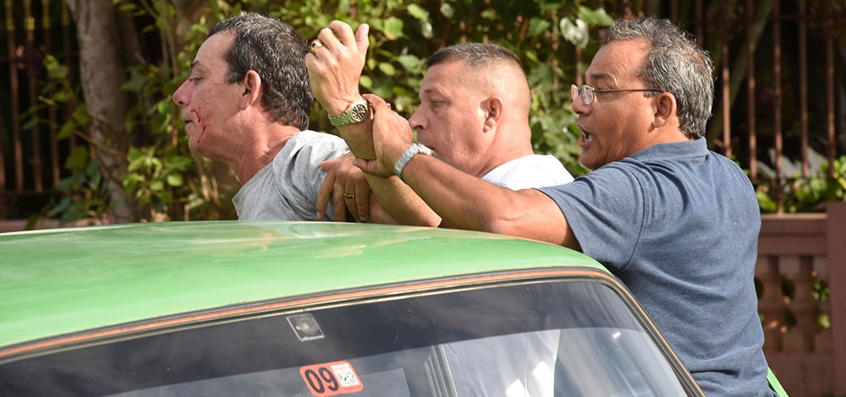

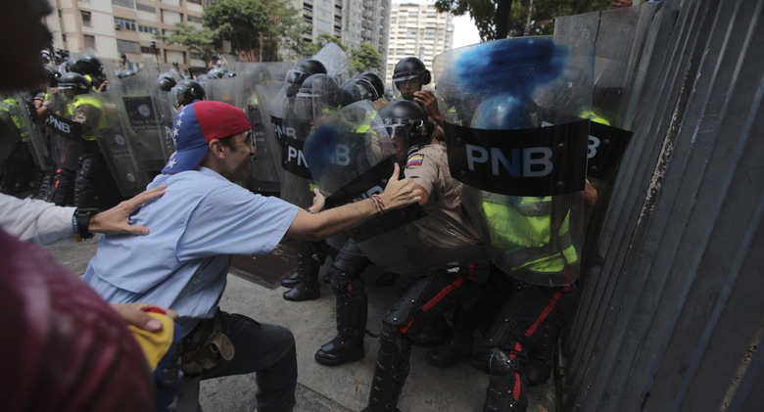

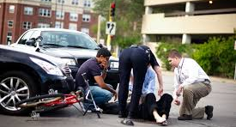
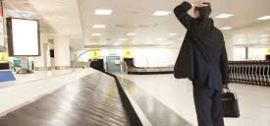
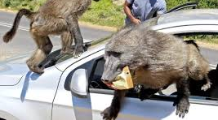
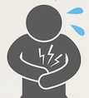
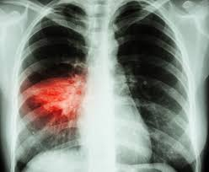
Personal
experience
Personal
experience
HAVANA
COSTA RICA & MEXICO
MANCHESTER
CARACAS
ROME
PANAMA
GUATEMALA
CALCUTTA
WASHINGTON
SOUTH AFRICA
Notes:
https://www.nytimes.com/2018/02/21/business/economy/fed-economy.html
http://www.worldbank.org/en/news/press-release/2018/01/09/global-economy-to-edge-up-to-3-1-percent-in-2018-but-future-potential-growth-a-concern
Source: The New Talent Landscape. Society for Human Resources Management (SHRM). 2016

Slide 4










TRAVEL RISK MANAGEMENT
Organizations need to be able to…
EDUCATE
PREPARE + MONITOR
NOTIFY
ADVISE
LOCATE
COMMUNICATE
FIND
ASSIST
SUPPORT
INSIGHTS
RISK MITIGATION
INCIDENT MANAGEMENT
Provide my people with information about the risks they may encounter and what these risks mean to them
Understand the risks my people will be exposed to, mitigate for them, and stay informed about how these risks are changing
Know when something is happening
Know what this incident means to me & what
I should do
Know where my people are
Communicate with my people to confirm their status
Find any employees that remain unaccounted for
Provide easy access to medical &/or security support to impacted employees
Go beyond
the immediate medical & security needs for longer term recovery
Learn from past events to better prepare for future events

Slide 5
RISK OUTLOOK
2024

Slide 6






METHODOLOGY & DERMOGRAPHICS
Africa
11%
The Risk Outlook 2024 survey was conducted among International SOS worldwide contacts and clients, of which 675 participated. Fieldwork took place online from October 10th to November 10th, 2023.
11%
Primary decision maker
Americas
23%
65%
Middle East
7%
Decision-making team and have significant influence on the final decision
Asia
27%
24%
Europe
24%
Decision-making team but do not have significant influence on the final decision
Oceania
7%

Slide 7

AGREE / DISAGREE
To what extent, if at all, do you agree or disagree with the following statements:
68
62
51
34
30
DUTY OF CARE

Slide 8
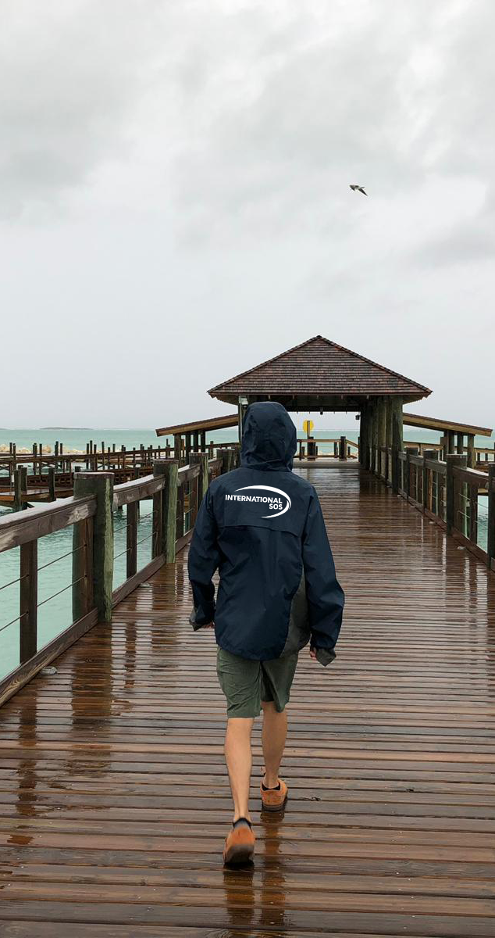







NEXT YEAR’S PERCEIVED RISK LEVEL
Thinking about the challenges your organisation currently faces in ensuring the health, wellbeing, and security of your people: Do you expect these challenges to increase, decrease or stay about the same over the next 12 months?
Africa
52
27
18
Europe
69
26
2
Americas
71
27
3
Middle East
62
20
18
Asia
64
29
7
Oceania
59
33
8
WORLDWIDE REACH. HUMAN TOUCH.

Slide 9
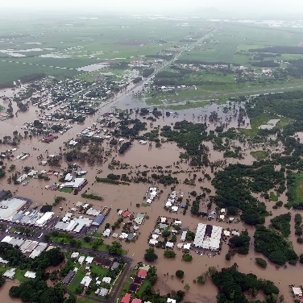

PREDICTIONS 2024
1.
STORM WARNING: CLIMATE CHANGE COMES HOME
2.
RUNNING ON EMPTY: THE PERMACRISIS TAKES ITS TOLL
3.
A DIFFERENT PLANET: GLOBAL INSTABILITY DEEPENS
4.
ALL GROWN UP: AI BRINGS NEW RISKS AND OPPORTUNITIES
5.
CONTRACT CHANGES: NAVIGATING THE NEW EMPLOYMENT RELATIONSHIP

Slide 10


THE POLYCRISIS
A polycrisis is not just a situation where you face multiple crises. It is a situation … where the whole is even more dangerous than the sum of the parts.
Adam Tooze, Professor of History, University of Columbia
As an international company, it's hard to manage so many risks globally as employees have different challenges across the globe.
Decision Making Team Member, Operations, Poland

Slide 11

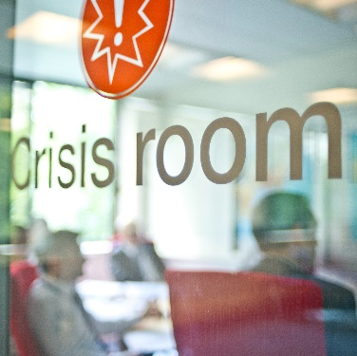

TOP PERCEIVED RISKS
How likely do you think it is that the following issues will have a significant impact on your business and/or your people in the next 12 months?
80%
75%
74%
STRESS & BURNOUT
CYBER-ATTACKS & CRIME
GEOPOLITICAL TENSIONS
73%
72%
72%
IMPACTS OF THE COST IF LIVING CRISIS
EXTREME WEATHER EVENTS
MENTAL HEALTH CONDITIONS

Slide 12
GEOPOLITICAL TENSIONS

Slide 13


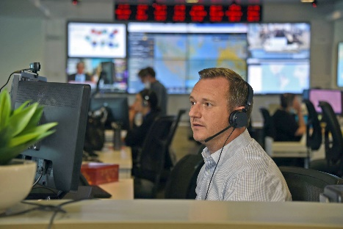



THE NEW RISK ENVIRONMENT
MANAGING IN PERMA-CRISIS
The risk paradigm has changed. Over the last year we have seen how debt, war, disease and inflation has fundamentally changed the risk landscape - both domestically and internationally.
85%
2.1x
11%
2x
84%
organisations
reported their employees’ appetite to travel is linked to the level of support their company provides to its travelers*
85% of risk professionals
agree the world has become more dangerous over the past twelve
months*
Mobile workers are
now 2.1x more likely to call us for advice or assistance than pre-COVID
Content is
now even more critical, we’ve seen an 11% increase in the readership
of medical &
security alerts
Due to the
complexity of the
risk environment
2x more outbound calls are required
to provide
assistance
*On behalf of International SOS, Ipsos carried out an online survey among 1,218 risk professionals across 108 countries. Fieldwork took place October 2022.
Notes:
Perma-crisis definition: an extended period of instability and insecurity, esp one resulting from a series of catastrophic events​
The risk paradigm has changed. Over the last year we have seen how debt, war, disease and inflation has fundamentally changed the risk landscape of business travel - both domestically and internationally.​
85% of risk professionals agree the world has become more dangerous over the past twelve months - the highest percentage since we started asking the question in 2014*. ​
​
This is supported by a 11% increase in the readership of our medical and security alerts issued by us in 2022. ​
Employees now expect a heightened level of support, with travelers being 2.1x more likely to call us for advice or assistance than pre-COVID.​
The complexity of the risk environment is further validated through analysis of our case data today vs pre covid. It now takes 2 x more outbound calls from our Assistance Centres to ‘close the case’ or provide the assistance required by the traveller, assignee or manager asking for our advice or assistance.​
​
We continue to support our clients through uncertain times, helping you keep your global workforce safe in a world of altered risk profiles. ​
At the same time when we surveyed 1200 senior risk professionals across the globe 84% reported their employees appetite to travel is linked to the level of support their organisation provides to travelers. [1] On behalf of International SOS, Ipsos carried out an online survey among 1,218 risk professionals across 108 countries. International SOS provided Ipsos with the sample which consisted of customers and contacts. Fieldwork took place between 2 - 28 October 2022 ​
​

Slide 14
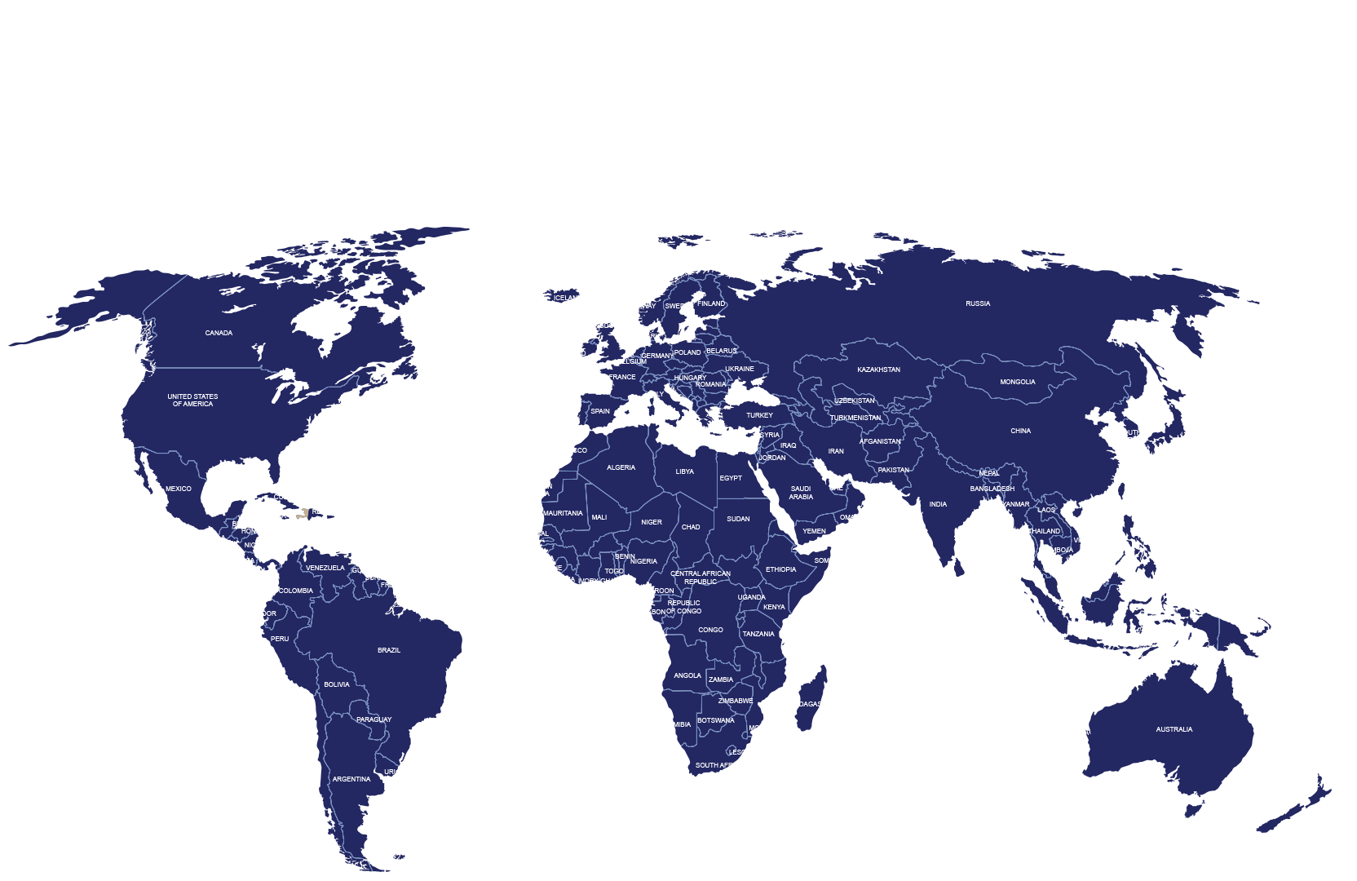
2023 SECURITY ESCALATIONS
Jan
Feb
Mar
April
May
June
July
Aug
Sep
Oct
2021
2022
2023
Canada
Tornado
Russia/
Ukraine
Tensions
Germany
Shooting
Afghanistan
Earthquake
USA
Shooting
Turkey
Earthquake
USA
Tornado
Greece
Train collision
Afghanistan
Explosion
Israel
-Gaza
Crisis
Niger
Coup
India
Cyclone
Mocha
Nigeria
Unrest
Sudan
Coup
Somalia
Mortar attack
Guam
Cyclone
Mawar
Sierra Leone
Unrest
Gabon
Coup
Vanuatu
Earthquake
New Zealand
Cyclone Gabrielle
Notes:
Alerts&SpecialAdv - Power BI

Slide 15
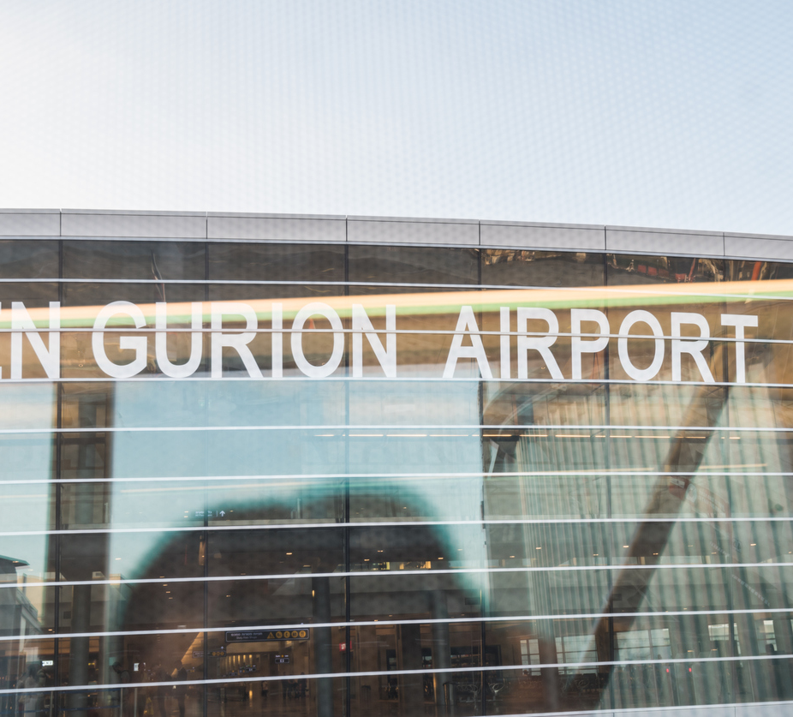

CHALLENGE
EVACUATIONS DURING THE ISRAEL-HAMAS CONFLICT
With few commercial flights, organizations needed options to evacuate their personnel from Israel. International SOS arranged charter flights to accommodate these travelers, who were in various locations and had to meet at the airport. Some individuals were based as close as 6 miles from the Gaza border. Coordinating their safe ground transportation on short notice was significant, and the ongoing conflict added to the logistics.
EVACUATIONS, INTELLIGENCE, SAFETY AND SECURITY IN A TIME OF NEED
International SOS conducted more than 50 transfers of over 100 people and supported other requests for assistance and evacuations, as well as arranging multiple charter flights.
Personnel had to be quickly and safely transported from various parts of Israel to Ben Gurion International airport for the flights. Our dedicated Incident Management Team was also on the ground to facilitate requests.
SOLUTION
International SOS worked with its network of in-country security partners to conduct pick-ups from various locations to the airport. In one instance, a group of travelers near Gaza had to be collected with urgency due to the public issuance of a very specific security threat where they were located.
KEY DIFFERENTIATORS
International SOS has the security and medical know-how and partners to successfully carry out missions to bring travelers and in-country personnel home safely.
IMPACT
All travelers were successfully evacuated, highlighting the critical role played by International SOS in providing timely and life-saving support to clients during crises.
Notes:
Overview
Amidst the ongoing Israel-Hamas conflict, International SOS continues to support our clients, having already carried out more than 50 transfers of over 100 people and supported other requests for assistance and evacuations. International SOS arranged multiple charter flights for clients with personnel across Israel. All personnel had to be safely transported in a timely manner from various parts of Israel to Ben Gurion International airport for the flight. Our dedicated Incident Management team (IMT) was on the ground to help facilitate the safe and successful evacuation for these individuals.
Problem
With the diminished number of commercial flight options available, many organizations sought options to evacuate their in-country personnel from Israel.
International SOS was able to arrange several charter flights to accommodate these travelers. The challenge was that many of the travelers were spread across various locations in Israel, and all had to meet centrally, at Ben Gurion International airport for their evacuation flight. Some of these individuals were based as close as 6 miles (10km) from the Gaza border. Coordinating their safe ground transport to the airport on short notice in time for the flight was a significant challenge. The ongoing conflict made it difficult to ensure everyone's safety while moving them to the designated point of departure.
Solution
International SOS worked with its network of in-country security partners to conduct pick-ups and safely transport these individuals from various locations to the airport. In one particular instance, a group of travelers in a city near Gaza needed to be collected with urgency due to the public issuance of a very specific security threat to the city in which they were located. With the escalating danger, we activated our security partner to expedite the pick-up of the travelers.
Impact
Thanks to the coordinated efforts of International SOS and its on-the-ground security partners, all travelers were successfully evacuated. This case highlights the critical role played by International SOS in providing timely and life-saving support to its clients during crises.

Slide 16
STORM WARNING:
CLIMATE CHANGE COMES HOME

Slide 17

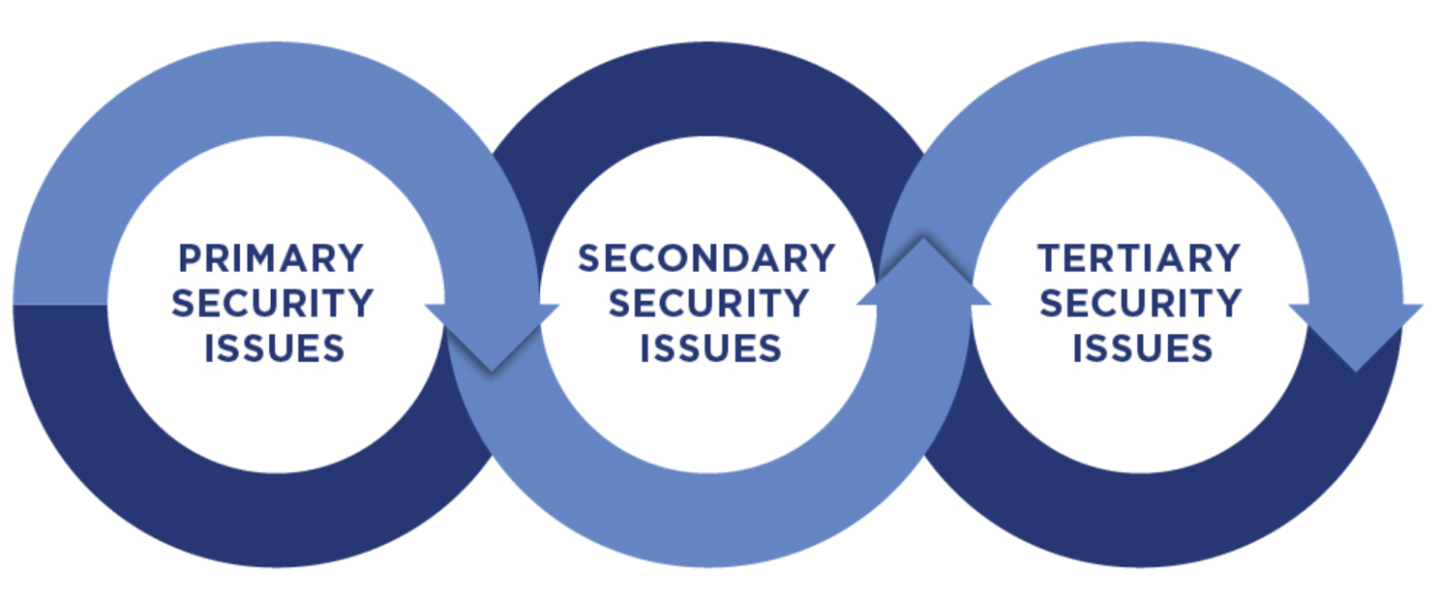
LAYERS OF ISSUES FROM CLIMATE RELATED EVENTS
PRIMARY, SECONDARY AND TERTIARY HEALTH AND SECURITY IMPACT
PRIMARY ISSUES
SECONDARY ISSUES
TERTIARY ISSUES

Slide 18
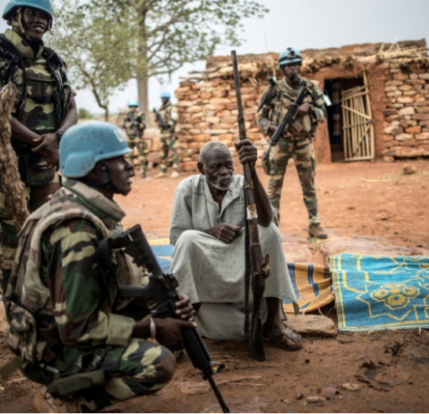
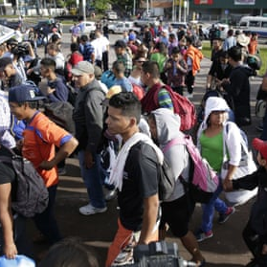
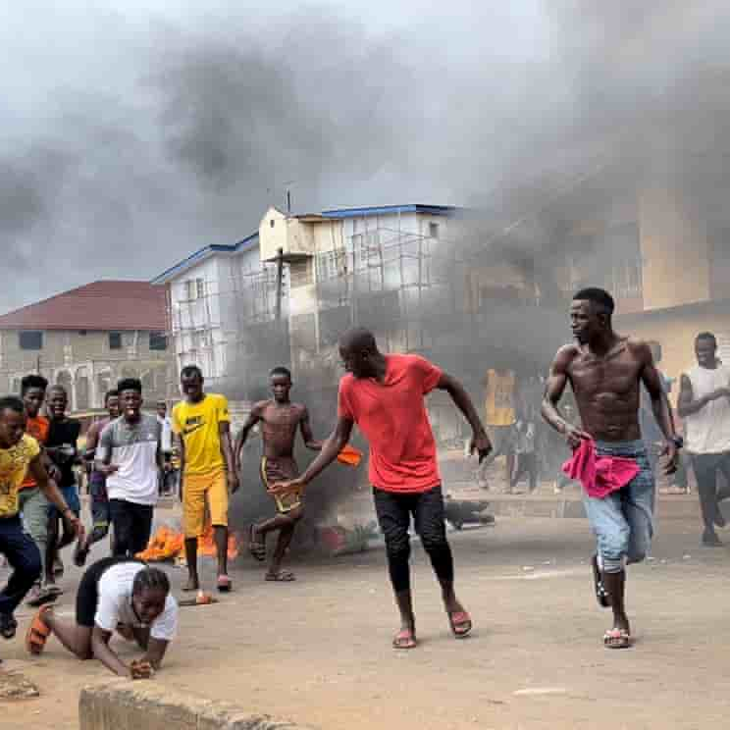
LAYERS OF ISSUES FROM CLIMATE RELATED CRISIS
SECONDARY & TERTIARY SECURITY IMPACT
DRIVER OF CONFLICT
MIGRATION
FOOD PRICE VOLATILITY
Members of MINUSMA force are shown here in central Mali’s Dogon region.
Migrants start their journey to the United States in San Salvador, El Salvador.
Photograph: Rodrigo Sura/EPA
People run away during an anti-government protest
in Freetown, Sierra Leone, on 10 August.
Photograph: Reuters

Slide 19

CHALLENGE
EVACUATION FROM HAWAII WILDFIRES
A request for help came to the Philadelphia Assistance Center from a senior leader at a US organization who was traveling on Maui with his family. With hotels, roads and airports crowded and space needed for residents, he was seeking a way to leave the island while not hindering local rescue efforts.
MARITIME EVACUATION SUPPORTING DUTY OF CARE IN A TIME OF NEED
In early August 2023, several wildfires – fueled by winds from a hurricane offshore – decimated parts of the Hawaiian island of Maui. Especially hard hit was Lahaina.
SOLUTION
International SOS experts determined that the best course of action was a maritime option. A tug boat was secured, and the six passengers were picked up on a beach in a safe area. Seven hours later, they arrived in Honolulu for a flight to the mainland US.
KEY DIFFERENTIATORS
International SOS has the right contacts at the right time to successfully conduct complex missions and evacuations. For this case, relationships with the maritime provider were forged half a world away during evacuations in Africa earlier in 2023. It’s local knowledge and committed partners that make the difference.
IMPACT
The family traveled home and did so without impacting the rescue and relief efforts that were ongoing on Maui.

Slide 20
RUNNING ON EMPTY:
THE PERMACRISIS TAKES ITS TOLL

Slide 21
PERCIEVED MENTAL HEALTH RISK OVER TIME
As questions have changed over time, these results are illustrative
Year | 2019 | 2020 | 2021 | 2022 | 2023
Question | Which of the following, do you think are most likely to cause your organisation to modify the itineraries of your business travelers or assignees in the next year? | Which of the following, do you think are most likely to cause a decrease in the productivity of your employees in the next year? | Which of the following issues do you think are most likely to cause a decrease in the productivity of your employees in the next year? | Which, if any, of the following do you think are most likely to have a negative impact on the productivity of a significant number of your employees in the next 12 months? | How likely do you think it is that the following wellness issues will have a significant impact on your business and/or your people in the next 12 months?
Base | 1346 | 1425 | 647 | 768 | 675
Respondent Type | All surveyed | All surveyed | Responsible for supporting business travelers (domestic & international) | Responsible for supporting business travelers (domestic & international) | All

Slide 22


BURNING OUT
Psychological, mental and emotional burnout. Employees are in a constant fight or flight mode, particularly those who work abroad. The EAP's are unable to cope with this new hybrid mental + emotional crisis.
Decision Making Team Member, C-Suite, Canada
Notes:
Available services are rapidly deteriorating due to demand.
Mental health map layer from 2022 to explain lack of available resources/capacity to manage across geographies

Slide 23




MENTAL crisis
Business traveler in Frankfurt
Experiences a mental crisis
Leaves wife a distressing voicemail…
Wife, rightfully panicked, starting making calls
Eventually routed to International SOS
Itinerary tracking; hotel identified
Wellness check, thankfully just in time…
Notes:
Full case study link: https://www.internationalsos.com/case-studies/case-study-folder/covid-19-education-for-a-diverse-workforce
Overview: International SOS provided best practice education about the COVID-19 pandemic to the employees of an American IT multi-national with large manufacturing & retail operations in Asia.
Problem: China, a country that has a widely dispersed population and is very well read, poses challenges in providing best practice tips to such a diverse society. Our client needed employees to return to Chinese retail stores and manufacturing sites after the Chinese New Year.
Solution: We were able to provide our client with multi-language educational webinars for employees around the world. These factored in our medical team's analysis, government directives, and open research. Subtitles were also provided for the hearing impaired, as well as recordings on our client's intranet for ease of access.
Impact: Employees were able to return to the corporate and retail sites. The company was able to resume business and able to guarantee continuity. Employees were reassured in the midst of the pandemic.

Slide 24
DON’T OVERLOOK
MEDICAL RISKS

Slide 25
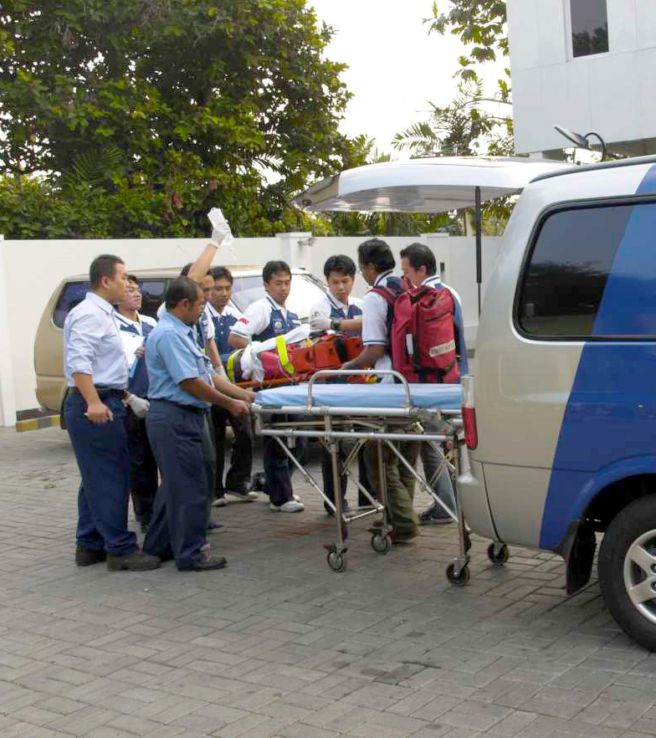
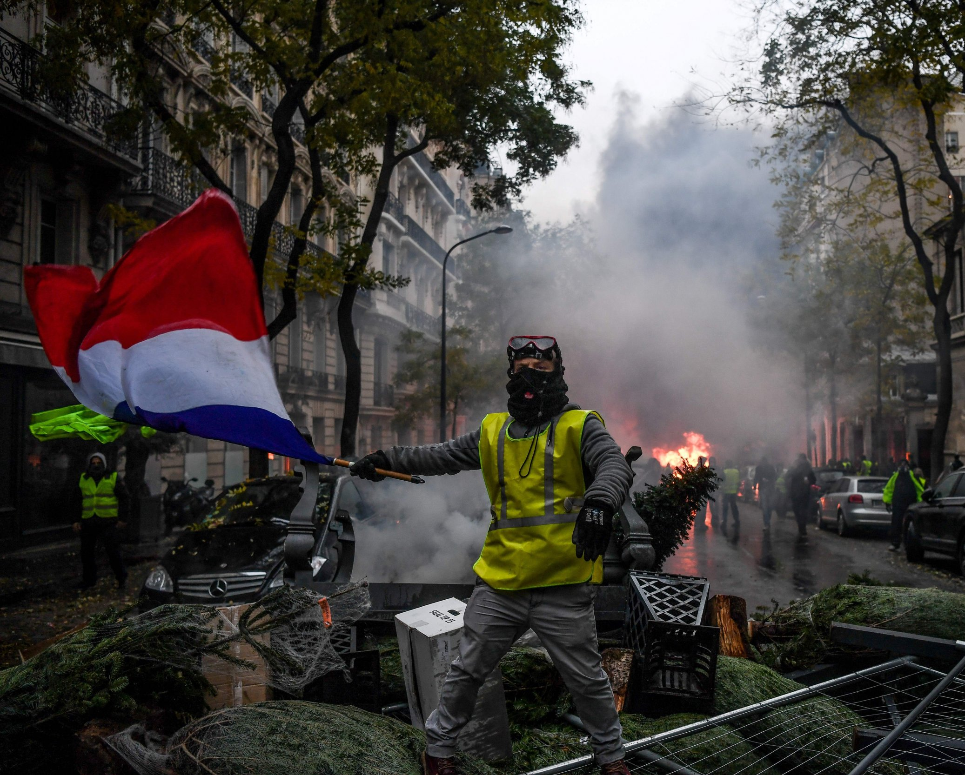
__%
__%

Slide 26
70%
30%

Slide 27



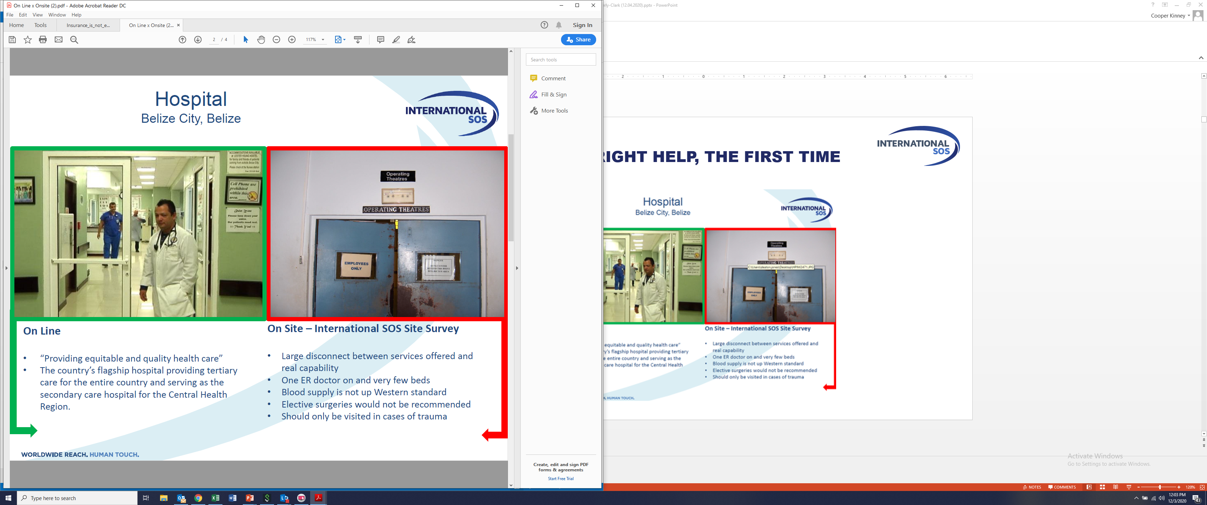
FINDING THE RIGHT HELP, THE FIRST TIME
KARL HEUSNER MEMORIAL HOSPITAL (BELIZE CITY)
Online Promotion
“Providing equitable and quality healthcare…”
“The country’s flagship hospital providing tertiary care for the entire country…”

Slide 28
FINDING THE RIGHT HELP, THE FIRST TIME
KARL HEUSNER MEMORIAL HOSPITAL (BELIZE CITY)
Online Promotion
“Providing equitable and quality healthcare…”
“The country’s flagship hospital providing tertiary care for the entire country…”
On Site Survey
Large disconnect between services offered and real capacity
One ER doctor on and very few beds
Blood supply not up to Western standard
Elective surgeries would not be recommended
Should only be visited in cases of trauma

Slide 29

Your appendix can burst anywhere
Brussels, Belgium
CEO of Fortune 1000 Company
Not feeling well in advance of trip
Two days into his trip, becomes incapacitated
Hotel arranges medical transport
Arrives at (the wrong) hospital
Passport seized
On a gurney for 5 hours in a dimly lit hallway
COO in the US tries to manage from afar…
Notes:
Full case study link: https://www.internationalsos.com/case-studies/case-study-folder/covid-19-education-for-a-diverse-workforce
Overview: International SOS provided best practice education about the COVID-19 pandemic to the employees of an American IT multi-national with large manufacturing & retail operations in Asia.
Problem: China, a country that has a widely dispersed population and is very well read, poses challenges in providing best practice tips to such a diverse society. Our client needed employees to return to Chinese retail stores and manufacturing sites after the Chinese New Year.
Solution: We were able to provide our client with multi-language educational webinars for employees around the world. These factored in our medical team's analysis, government directives, and open research. Subtitles were also provided for the hearing impaired, as well as recordings on our client's intranet for ease of access.
Impact: Employees were able to return to the corporate and retail sites. The company was able to resume business and able to guarantee continuity. Employees were reassured in the midst of the pandemic.

Slide 30
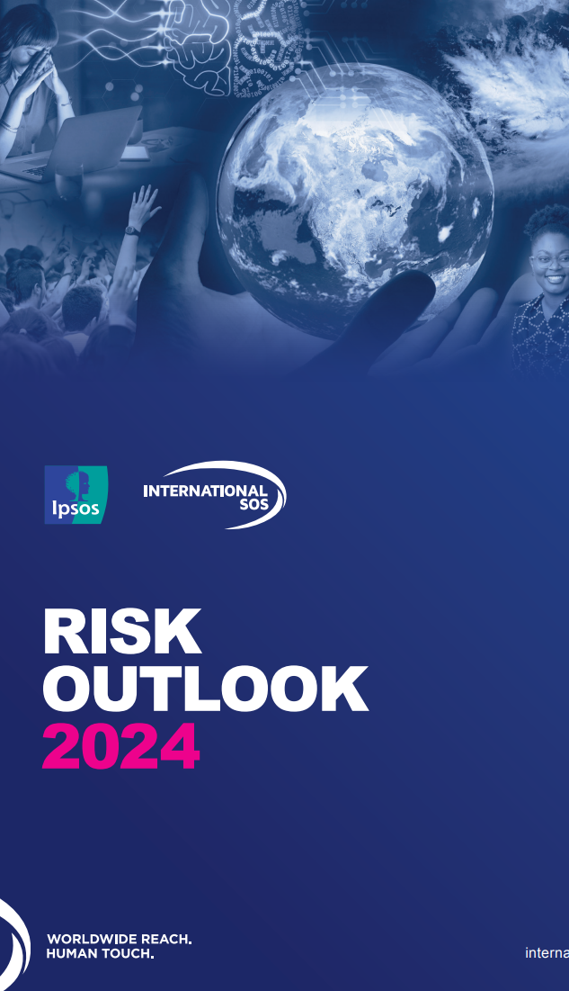
KEY TAKEAWAYS + Q&A
How do you…
Prepare your travelers for the risks they might encounter?
Stay informed of events in locations your people operate or travel?
Locate and communicate with travelers during a crisis?
Assist travelers on the ground during a crisis?
https://www.internationalsos.com/risk-outlook
cooper.kinney@internationalsos.com

Slide 31
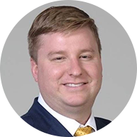

Welcome Back:
Eddie Raleigh

Slide 32



Immigration Compliance 2.0
2024 Updates for U.S. Conferences and Business Events

Slide 33

Mitigating Risks of Crossing Borders
Help travelers take a compliance-cognizant approach to ensure successful business travel.
Crossing international borders always carries risk.
But in-person meetings and events create opportunities to connect with colleagues and experts across borders.
Today, we will:
  Introduce the ABCs of compliance,
  Review need-to-know business travel rules,
  Discuss the election’s implications for business travel.

Slide 34



ABCs of Business Travel Compliance
Honesty is the best policy.
Attestations
Border
Consulate
All statements made in immigration documents and letters must be true.
Representations made to Customs and Border Patrol officers about travel and activities must be honest.
Everything said to a consular officer and all documents brought to the U.S. consulate must be accurate.
Notes:
What you say and what you submit must be truthful.
Border
CBP is the DHS component that handles admission into the United States at borders and ports of entry.
CBP also administers the Electronic System for Travel Authorization (ESTA) that people from Visa Waiver Program countries use to register U.S. travel in advance.
People seeking lawful entry must establish their admissibility to a CBP officer upon arrival.
Sometimes, CBP conducts secondary inspections to determine whether someone can enter.
In some cases, CBP may deny entry.
Consulate/State Department
Most people abroad must apply for travel authorization before coming to the United States.
For most attendees, this means applying for a U.S. B-1 business or B-1/B-2 visa submitting the DS-160 to the U.S. Department of State.
Applicants typically complete a visa interview in their home country at the nearest U.S. embassy or consulate.
Wait times and procedures for a consular interview vary by post.
B-1/B-2 visas are valid for up to ten years and allow the visa holder U.S. visits for work and leisure.

Slide 35






Business Travel: Key Things to Keep in Mind
B visas are for nonimmigrant visitors entering the United States temporarily for business or pleasure.
Purpose: When is travel authorized? Is the visit’s purpose accurately stated?
Invitation letters: What are the policies and controls to ensure invitation letters are legitimate, accurate, and complete? Who is authorized to sign?
Conduct: Do business travelers comply with restrictions on productive work and abide by visit terms?
Duration: Do travelers depart prior to the expiration of lawful status?
Notes:
Similar requirements and limitations on people from ESTA eligible countries

Slide 36


What Business Travelers Can Do
Consult with business associates
Attend a convention or conference
Negotiate contracts
Train others for a limited time
Bring goods or products into the United States to solicit orders on a temporary basis
On B-1/B-2 Visitor Visa, one CAN ALSO:
Take in the sights as a tourist
Visit friends or relatives
Vacation or enjoy holiday activities

Slide 37
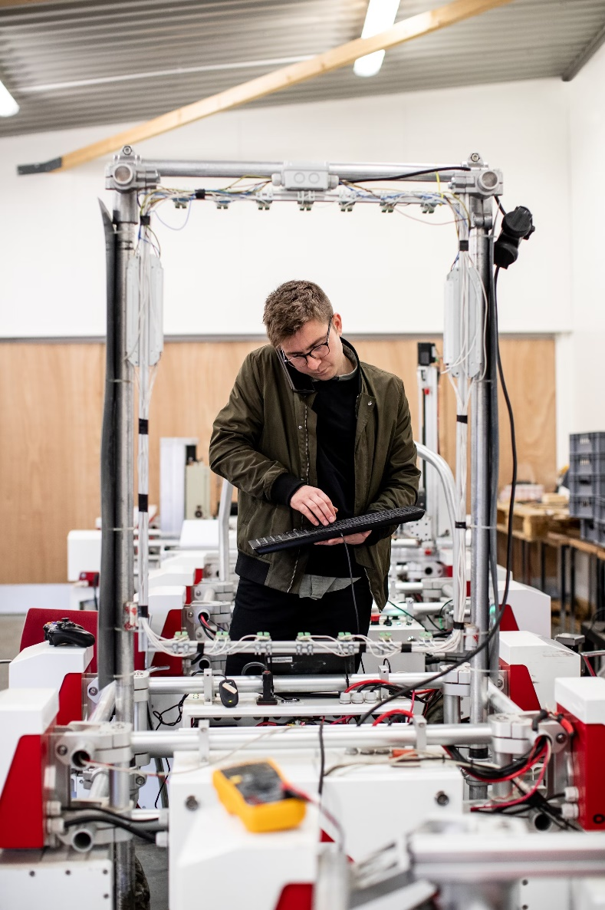
What Business Travelers Cannot Do
Join production line of company and build robots, electronics, cars, bridges, etc.
Work a side job like driving Uber or delivering food
Take courses credited towards a degree
Act in a show, perform in a band, or do any professional performance before a paying audience
Work in radio, film, print journalism, or as foreign press
Make money in the United States by selling goods or products
Overstay
Notes:
Many of these require work authorization from USCIS

Slide 38


Compliance Cognizance in Action
Helping travelers be aware and prepared for a compliant trip
Conform to the terms of the visit—know what can and cannot be done, length of allowed stay, etc.
Tools streamline reminders and put information at their fingertips
Avoid mistakes that can have costly consequences, including:
  Failing to review/verify information before signing
  Relying on stale, pre-signed invitation letter templates
Know when to seek help and provide resources accordingly.
Travelers need to understand the risks, responsibilities, and repercussions associated with traveling to the United States.
Notes:
You have a crucial role to play in equipping business travelers with what they need to know.
Example of when to seek help—if someone is detained at the border or if an attendee commits a crime
One common misconception is that business travel to the United States is not a big deal—it is just a little business trip. But the U.S. government takes these rules very seriously. Any lie on an attestation to a government agency or official can have major consequences, resulting in financial penalties or even being barred from the United States for certain violations. It is always best to follow the ABCs.

Slide 39


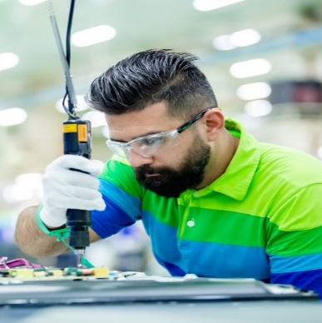

Check Your Understanding
Jan is from Slovakia.
Comes through ESTA to attend a conference
Picks up a few Uber Eats shifts on the side
Nur is from Malaysia.
Comes on a B visa to consult with business colleagues for two weeks
Spends another week visiting friends in another city
Reza is from Canada.
Comes to train junior colleagues at his company’s U.S. facility
Helps team meet tight delivery deadlines by manufacturing equipment on the line
Yuvan is from India.
Comes on a B visa to negotiate some contracts and solicit orders for his company
Showcases his musical talent at a fundraiser concert

Slide 40


Check Your Understanding
Jan is from Slovakia.
Comes through ESTA to attend a conference
Picks up a few Uber Eats shifts on the side
Nur is from Malaysia.
Comes on a B visa to consult with business colleagues for two weeks
Spends another week visiting friends in another city
Reza is from Canada.
Comes to train junior colleagues at his company’s U.S. facility
Helps team meet tight delivery deadlines by manufacturing equipment on the line
Yuvan is from India.
Comes on a B visa to negotiate some contracts and solicit orders for his company
Showcases his musical talent at a fundraiser concert
Notes:
With a compliance cognizant approach, these guys may have known better and avoided penalties. Maintaining a compliance-cognizant approach is even more important when there is greater scrutiny on people crossing the U.S. border for business.

Slide 41

Turbulence Ahead? Election Impact
The U.S. presidential election could have major implications for global business travel.
Heightened scrutiny on business travel
Increased penalties for violations for individuals and companies
Reduced access to consular appointments and/or long processing delays
Security screenings and secondary inspections for people from certain countries, backgrounds, or viewpoints
Possibility of travel bans
Notes:
This year, an unprecedented number of people around the globe will be heading to the polls to vote.
The U.S. presidential election looms large, and we are facing the possible return to more restrictionist policies on immigration and cross-border travel.
Should Trump prevail, there will be risks to contend with in business and event travel.
Regardless of the ultimate outcome, a Biden-Trump contest may have a chilling effect on incoming U.S. business travel as companies take a wait-and-see approach to travel. https://www.gbta.org/uncertainty-over-travel-ban-puts-business-travel-and-the-economy-at-risk/
We have seen each person in the White House and can plan and anticipate some of these outcomes.

Slide 42

Making Compliance Count
1 | Check for high-risk practices that could be flagged.
2 | Maintain a secure process for inviting foreign attendees and strengthen invitation letter protocols to reduce fraud risk.
3 | Stay aware of processing trends and agency changes.
4 | Advocate for improvements through the GBTA Government Relations Committee.
5 | Companies can consider integrating checks into internal systems to ensure conformity with terms of visit.
6 | Encourage attendees to apply for visa or ESTA as soon as possible to avoid delays.
7 | Understand different attendees’ needs depending on country of citizenship, status or work type, and any complicating factors.
8 | Prepare resources for travelers that may face extra scrutiny.
Notes:
Being aware is the first thing to prepare.
High risk practices include:
long trips using B visas,
multiple B visa trips in succession,
trips for which the stated purpose of the travel does not appear to match the visa category
Invitation Letters:
Establish clear, centralized protocols for invitation letters
Identify proper points of contact and signing authority
Secure and control letterhead and signatures: avoid signed templates
Maintain documentation, including a list of foreign invitees
Variety of assessment mechanisms and ways to track from system confirmations to internal audits.
Different attendee needs:
Someone from Iran, Iraq, Libya, Somalia, Sudan, Syria, and Yemen—countries of the original Trump travel ban—would face more uncertainty and scrutiny in their business travel journey
Status type example: specialized worker category like H-1B who travels in and out of the United States frequently

Slide 43


Conclusion
Remember the need for honesty on ABCs of compliant travel:
Take a compliance-cognizant approach that empowers travelers to do the right thing.
Assess risk exposure and take corrective action that counts.
Attestations
Border
Consulate
Staying compliant on U.S. work and immigration matters will help your attendees and your organization to avoid friction.

Slide 44

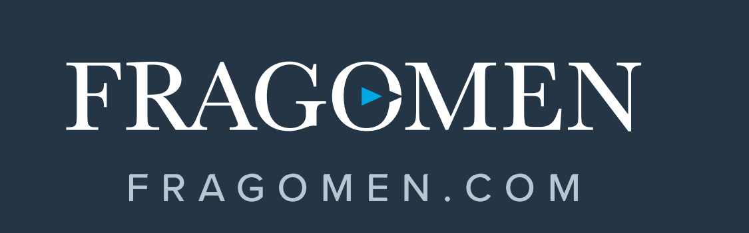

Eddie Raleigh
Fragomen Partner
GBTA Government Relations Committee Member
keraleigh@fragomen.com

Slide 45





Visit Us on Social Media
GBTA Chicago LinkedIn Page
GBTA | Chicago
GBTA - Chicago
gbta_chicago
@ChicagoBTA

